Slide 1
Shear conditions
Shear deformation of soil:
$$τ_{p}$$
Peak
$$x$$
$$z$$
$$σ_{z}$$
Dense sand
$$τ$$
Shear stress, τ
Softening
Hardening
$$∆z$$
$$τ_{cs}$$
Critical state
Hardening
Loose sand
$$H_{0}$$
$$A_{0}$$
$$∆x$$
Shear strain, γ_{zx}
$$γ_{zx}=\frac{∆x}{H_{0}}$$
Shear strain
Compression
Loose sand
Critical state
$$ε_{v}=\frac{∆V}{V_{0}}=\frac{A_{0}∆z}{A_{0}H_{0}}=\frac{∆z}{H_{0}}$$
Volumetric strain (compression is positive)
Volumetric strain, ε_{v}
Shear strain, γ_{zx}
Expansion
Critical state
$${\left(\frac{∆ε_{v}}{∆γ_{zx}}\right)}_{max}$$
Dense sand

Slide 2
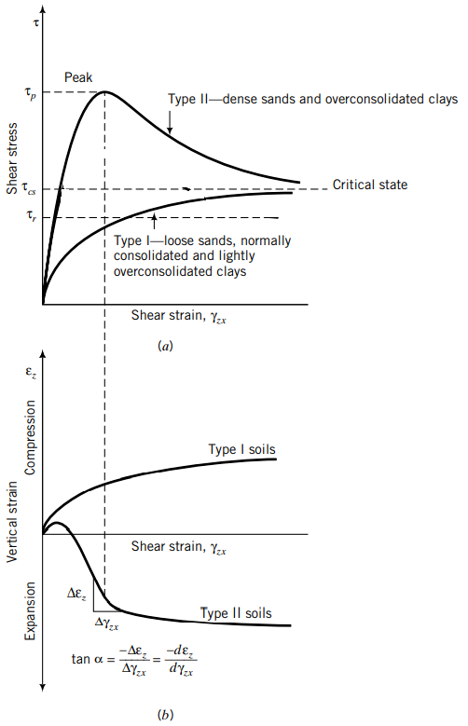
Shear conditions
Consider 2 types of soil under shearing conditions (drained)
Type I soils—loose sands, normally consolidated and lightly overconsolidated clays (OCR < 2): gradual increase in shear stresses (strain-hardens) until the critical state shear stress. Compress during shearing
Type II soils—dense sands and heavily overconsolidated clays (OCR>2): rapid increase in shear stress reaching a peak value at low shear strains and then show a decrease in shear stress with increasing shear strain (strain-softens), ultimately attaining a critical state shear stress. Initially compress a bit, but then dilate during shearing (DILATANCY).
Residual state
Budhu, M. (2008). Soil mechanics and foundations. Wiley Textbooks.

Slide 3
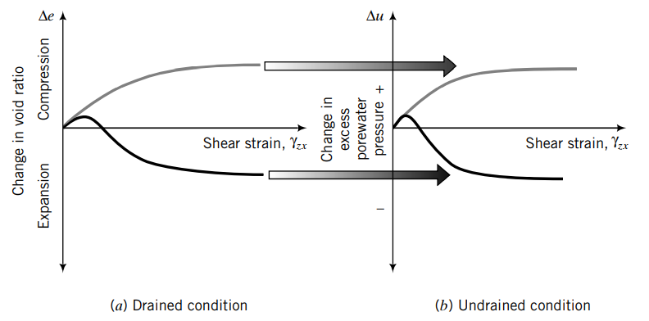
Undrained conditions
Drained condition occurs when the excess pore water pressure developed during loading of a soil dissipates, i.e., Δu= 0. (typical of sand, and clay at long term)
Undrained condition occurs when the excess pore water pressure cannot drain, at least quickly, from the soil, $∆u≠0$. (typical of clay at short term)
Budhu, M. (2008). Soil mechanics and foundations. Wiley Textbooks.

Slide 4
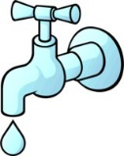
Undrained conditions
ε_{a}
ε_{v}
Drained conditions
Undrained conditions
ε_{v}
$$σ_{1}$$
$$σ_{1}$$
Water flows out/in
Water can not flow out/in
Δε_{v}≠0
Δε_{v}=0
$$σ_{3}$$
$$σ_{3}$$
$$σ_{3}$$
Δu≠0
$$σ_{3}$$
Δu=0
$$σ_{1}$$
$$σ_{1}$$
Compression (+)
Normally consolidated clay
Pressure (+)
Normally consolidated clay
Critical state
Critical state
Volumetric strain, ε_{v}
Excess pore pressure, Δu
Axial strain, ε_{a}
Axial strain, ε_{a}
Expansion (-)
Critical state
Suction (-)
Critical state
Overconsolidated clay
Overconsolidated clay

