Slide 1
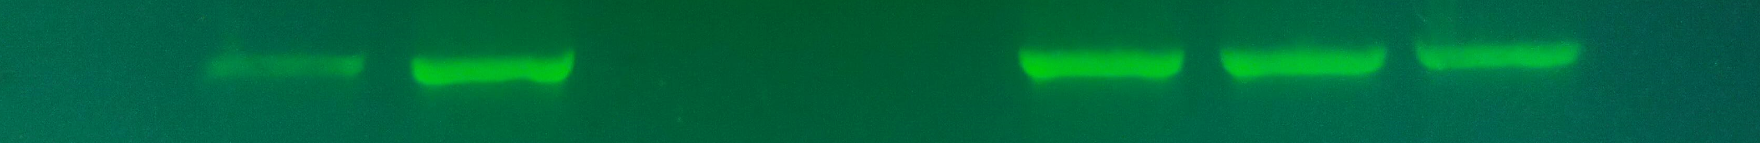
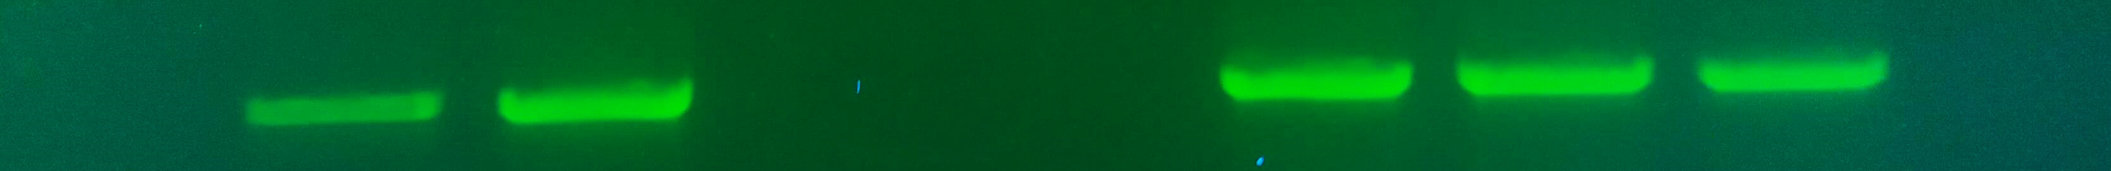
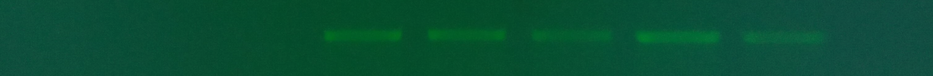
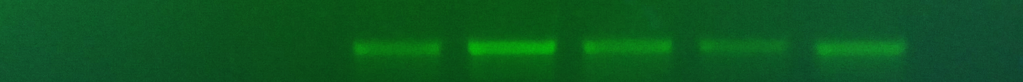
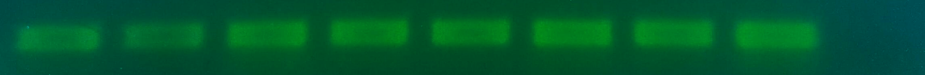
amb1a KO
amb1b KO
amb1a/b KO
WT #1 #2 #1 #2 #1 #2 #3 C-
AMB1a LB
AMB1a RB
AMB1b LB
AMB1b RB
ACT

Slide 2

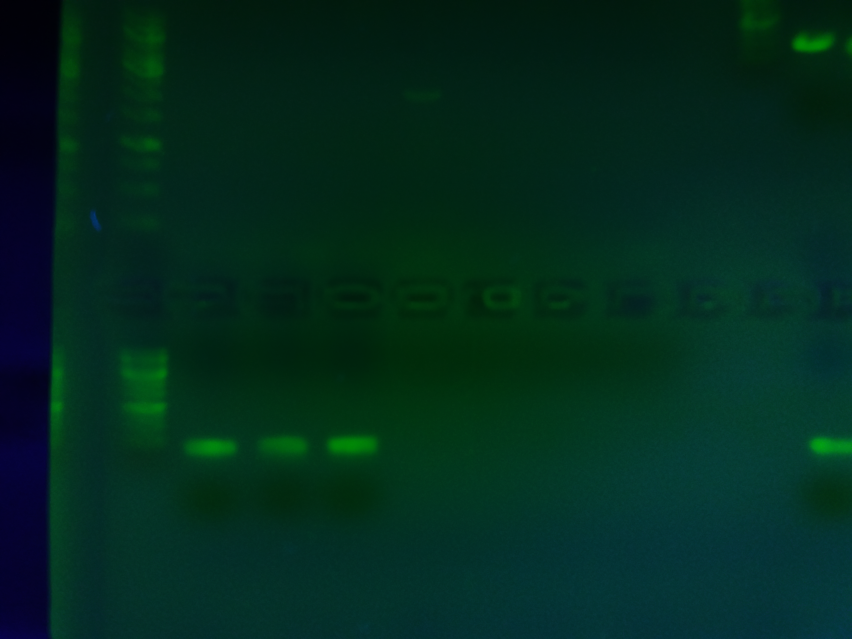

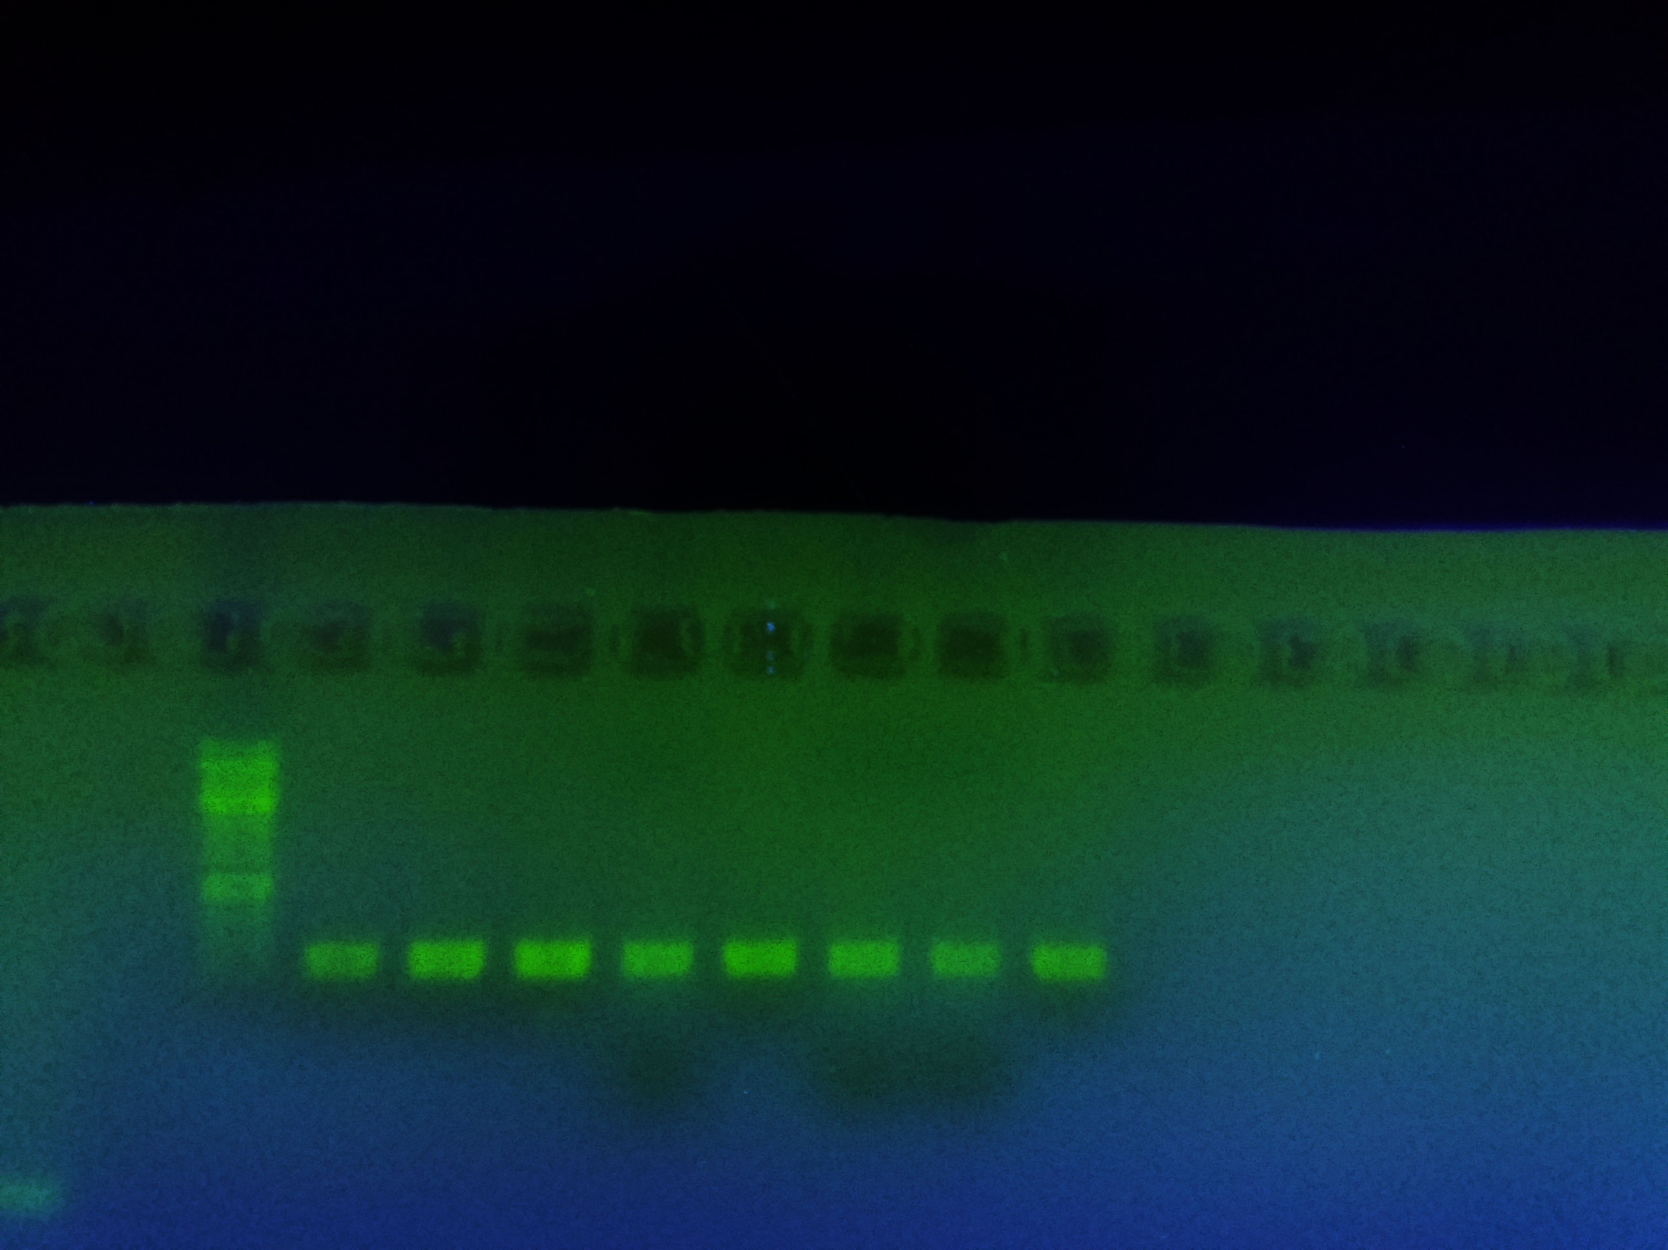
amb1a KO
amb1b KO
amb1a/b KO
WT #1 #2 #1 #2 #1 #2 #3 C-
AMBRA1A
AMBRA1B
AMBRA1A+B
ACT

